Slide 1
INF0 341 VLANs, Trunks, and 802.1Q
By
Bob Larson

Slide 2
Topics Covered
What is a Virtual LAN (VLAN)
VLANs Establish Broadcast Domains
VLAN Frame Identification (VLAN Tag)
IEEE 802.1Q Trunks (Tagging)
How it really works
VLAN Uses Example
To Verify Your VLANs – show vlan
Confirm Trunks – show interfaces trunk
Confirm Interfaces - show interface status

Slide 3
LAN Basics
Regular LAN
Two LANs
192.168.2.1
Router
Router
192.168.2.x
192.168.1.1
192.168.1.x
192.168.1.1
192.168.1.x
Switch 1
Switch 2
Switch 1
Switch 2
.2
.6
.9
.4
.15
.27
.2
.2
.9
.4
.6
.27
Nothing prevents you from putting two LANs (IP pools) on same switches
Hosts could not reach hosts on other network without a router – that never changes
Every host would hear broadcasts from both networks (less secure / more congestion)
Router would need two interfaces (or ability to put two IPs on one)

Slide 4
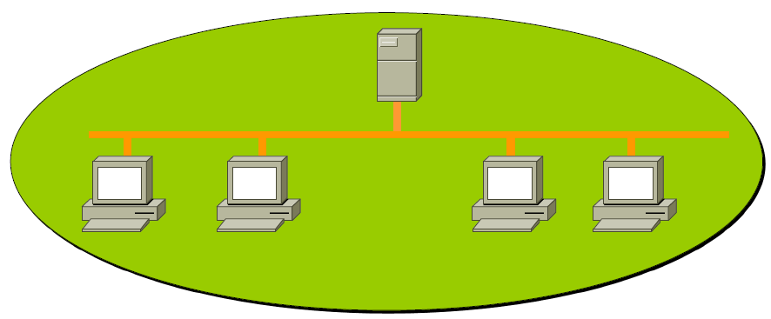
What is a Virtual LAN (VLAN)
A virtual Broadcast Domain within a switched LAN
Effectively segments switches into separate LANs
Invisible to each other (security improved, fewer broadcasts)
Each has its own IP address pool (Network)

Slide 5
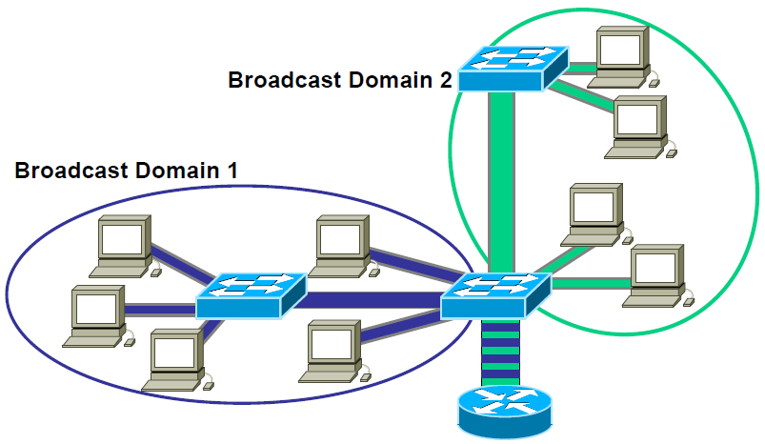
VLANs Establish Broadcast Domains
192.168.1.0/24
VLANS basically partition the network. Why? To carry multiple IP networks.
VLAN = IP Network
Trunk caries both Red and Green VLAN
Router
Trunk
192.168.2.0/24
Trunk
VLAN 2
Switch 1
Switch 2
VLAN 1
Trunk Link – Carries multiple VLANs (multiple IP networks)
VLANs contain broadcasts within originating domain (IP network)
Router is the only device that can forward traffic between VLANs
Routers do not forward broadcasts (keeps broadcast from spreading)

Slide 6
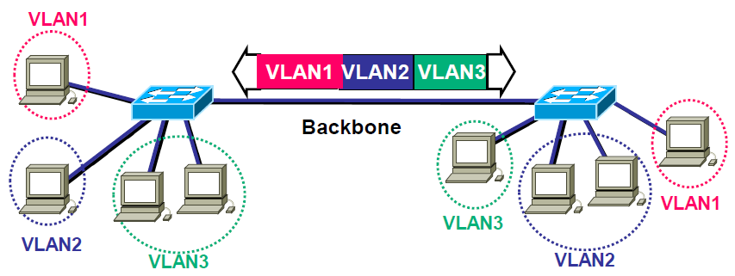
VLAN Frame Identification (VLAN Tag)
Trunk Link
Developed for multi-VLAN, inter-switch communications
Places a unique identifier (Tag) in header of each frame
Functions at Layer 2
Analogy: Color coded name badges at a conference or at work

Slide 7
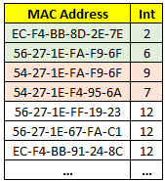
IEEE 802.1Q Trunks (Tagging)
Original Ethernet Frame
Router
z
Trunk
Ethernet vs. 802.1Q Frame
Trunk
Switch 1
Switch 2
x
y
CAM Table
B
E
F
Open standard using frame tags to label traffic
Inserts a 4-Byte header while within the VLAN switches
Like an Event Badge – determines where you can go
Switch only sees MAC addresses in that VLAN when forwarding
Just like the switch is partitioned, so is the CAM table
Header added at x for frame from A / removed at z or y

Slide 8
IEEE 802.1Q VLAN Identification Tag
Original Ethernet Frame
Ethernet vs. 802.1Q Frame
The industry standard
2-byte Tag Protocol Identifier (TPID)
A fixed value of 0x8100
Indicates the frame carries 802.1Q/802.1p tag information
2-byte Tag Control Information (TCI)
VLAN Identifier plus Priority and Drop Eligible codes

Slide 9
How it really works – Scenario #1
B
192.168.1.7/24
All other devices in the 192.168.2.0/24 network or 10.0.0.0/24 network
192.168.1.15/24
A
C
192.168.1.163/24
Switch
Switch
No VLANs – Blue devices could be Hubs or Switches
A, B and C could communicate or ping each other
They could not communicate with or ping any of the other devices
All other devices could communicate or ping each other
They could not communicate with or ping A, B or C
All devices would see all broadcasts – could be sniffed (WireShark)
Neither network could sniff the other’s unicasts (device to device traffic)

Slide 10
How it really works – Scenario #2
B
192.168.1.7/24
All other devices in the 192.168.2.0/24 network or 10.0.0.0/24 network
192.168.1.15/24
A
Switch Link
C
192.168.1.163/24
Switch
Switch
VLANs – Blue devices must be Switches
A, B and C are on ports configured for VLAN 2 (or any number but 1)
All other ports are in VLAN 1 by default
Devices in each VLAN no longer see any traffic from other VLAN
VLAN 1 devices can communicate with or ping each other (but not A, B or C)
A and B can communicate or ping each other – but C is an orphan (stranded)
Switch Link ports are in VLAN 1 (default) – can’t carry any other VLANs
Putting Switch Link ports are in VLAN 2 would connect A, B & C but would split VLAN 1

Slide 11
How it really works – Scenario #3
B
192.168.1.7/24
All other devices in the 192.168.2.0/24 network or 10.0.0.0/24 network
192.168.1.15/24
A
Switch Link (Trunk)
C
192.168.1.163/24
Switch
Switch
VLANs with trunk – Blue devices must be Switches
Switch Link ports are configured as trunks* for all VLANs (default)
A, B and C can now communicate (but not with VLAN 1 devices including the server)
VLAN 1 devices can communicate with each other (but not A, B or C)
Devices in each VLAN still no longer see any traffic from other VLAN
Nothing in this scenario will allow the VLANs to communicate with each other
* Must be full-duplex Ethernet 100 Mb minimum

Slide 12
How it really works – Scenario #4
B
192.168.1.7/24
All other devices in the 192.168.2.0/24 network or 10.0.0.0/24 network
192.168.1.15/24
A
Switch Link (Trunk)
C
192.168.1.163/24
Switch
Switch
Router
VLANs with trunks and router – Blue devices must be Switches
Router connected via Trunk to either switch
Configured with virtual interface in VLAN 1 (192.168.2.1/24 – default gateway for all VLAN 1 devices)
Configured with virtual interface in VLAN 2 (192.168.1.1/24 – default gateway for all VLAN 2 devices)
All devices can now communicate with each other
VLAN 1 devices directly, or through the router to get to VLAN 2 devices
VLAN 2 devices directly, or through the router to get to VLAN 1 devices
Life is good!

Slide 13
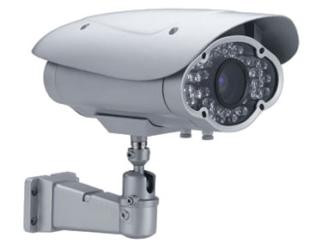
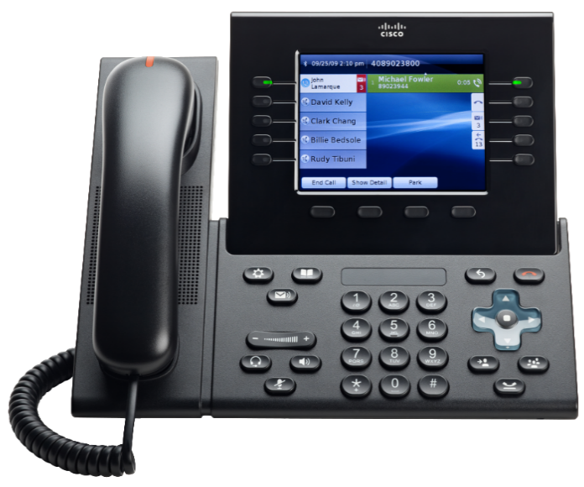
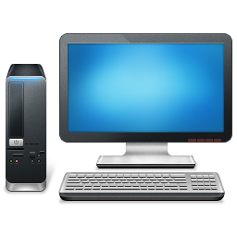
VLAN Uses Example
Router
Trunk
Trunk
Trunk
Switch 1
Switch 2
B
D
E
Part of the Red VLAN
Actually a 2-port switch 1 VLAN port for phone
1 for PC or Laptop
IP Desk Phones
Video Cameras
Door Access Card Readers
Credit Card Readers
Point of Sale Devices
Video Displays
Note: Computers B, D, and E could view the security camera directly. All others would need to go through the router (router could block).

Slide 14
To Verify Your VLANs – show vlan
Switch#show vlan brief VLAN Name Status Ports ---- -------------------------------- --------- ------------------------------- 1 default active Fa0/2, Fa0/3, Fa0/4, Fa0/5 Fa0/6, Fa0/7, Fa0/8, Fa0/9 Fa0/10, Fa0/21, Fa0/22, Fa0/23 Fa0/24, Gi0/1, Gi0/2 2 Sales active Fa0/11, Fa0/12, Fa0/13, Fa0/14 Fa0/15 3 Accounting active Fa0/16, Fa0/17, Fa0/18, Fa0/19 Fa0/20 1002 fddi-default active 1003 token-ring-default active 1004 fddinet-default active 1005 trnet-default active
* brief is optional – cleans up display at the bottom

Slide 15
Confirm Trunks – show interfaces trunk
Switch#show interfaces trunk Port Mode Encapsulation Status Native vlan Fa0/1 on 802.1q trunking 1 Port Vlans allowed on trunk Fa0/1 1,2 Port Vlans allowed and active in management domain Fa0/1 2 Port Vlans in spanning tree forwarding state and not pruned Fa0/1 2

Slide 16
Confirm Interfaces - show interface status
Switch#show interface status Port Name Status Vlan Duplex Speed Type Fa0/1 connected trunk a-full a-100 10/100BaseTX Fa0/2 notconnect 1 auto auto 10/100BaseTX Fa0/3 notconnect 1 auto auto 10/100BaseTX Fa0/4 notconnect 1 auto auto 10/100BaseTX Fa0/5 notconnect 1 auto auto 10/100BaseTX Fa0/6 IT Department VLAN connected 1 a-full a-100 10/100BaseTX Fa0/7 IT Department VLAN notconnect 1 auto auto 10/100BaseTX Fa0/8 IT Department VLAN notconnect 1 auto auto 10/100BaseTX Fa0/9 IT Department VLAN notconnect 1 auto auto 10/100BaseTX Fa0/10 IT Department VLAN notconnect 1 auto auto 10/100BaseTX Fa0/11 Sales Department V connected 2 a-full a-100 10/100BaseTX Fa0/12 Sales Department V notconnect 2 auto auto 10/100BaseTX Fa0/13 Sales Department V notconnect 2 auto auto 10/100BaseTX Fa0/14 Sales Department V notconnect 2 auto auto 10/100BaseTX Fa0/15 Sales Department V notconnect 2 auto auto 10/100BaseTX Fa0/16 Accounting Departm notconnect 3 auto auto 10/100BaseTX Fa0/17 Accounting Departm notconnect 3 auto auto 10/100BaseTX Fa0/18 Accounting Departm notconnect 3 auto auto 10/100BaseTX Fa0/19 Accounting Departm notconnect 3 auto auto 10/100BaseTX Fa0/20 Accounting Departm notconnect 3 auto auto 10/100BaseTX ****Output Omitted****

Slide 17
Fin…

